Slide 1
Simulation-Based Autonomous Driving in Crowded City
Summer 2023

Slide 2
Thread
Vehicle Detection
Traffic Light Detection
Lane Detection
Create Thread ?
Image Callback Function
Send Image
Simulator

Slide 3
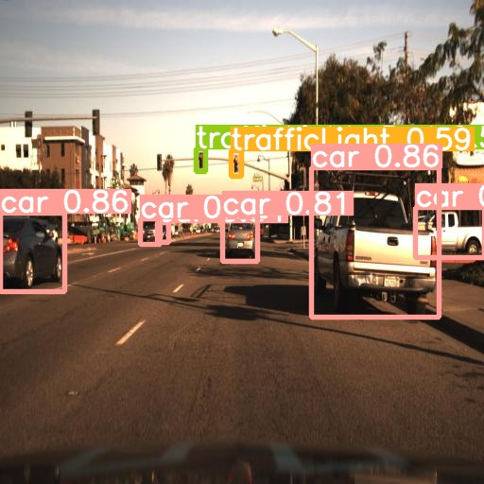
Object Detection
Classes
Traffic light
Other Vehicles

Slide 4
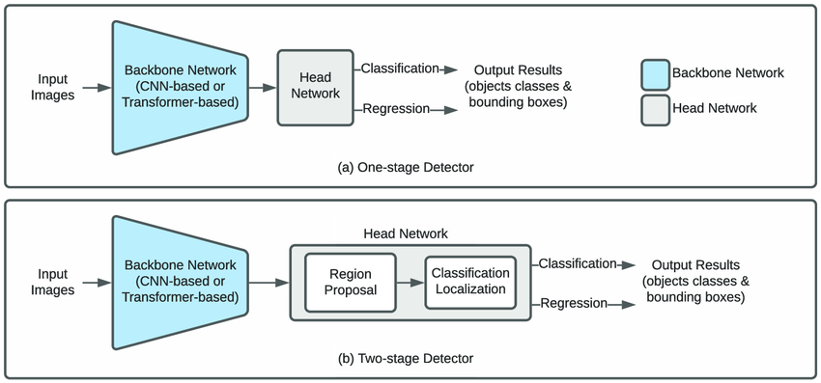
Choosing a Model
R-CNN
Slow Inference - ~10 seconds
Two-stage Detector
YOLOv8
One-Stage Detector
Wrong Traffic Light Detections

Slide 5
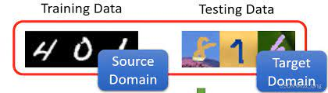
Fine Tuning
To Fix Wrong Traffic Light Detections
Domain Change
Fine tuned on a dataset
Removed some classes - bikes, ...

Slide 6
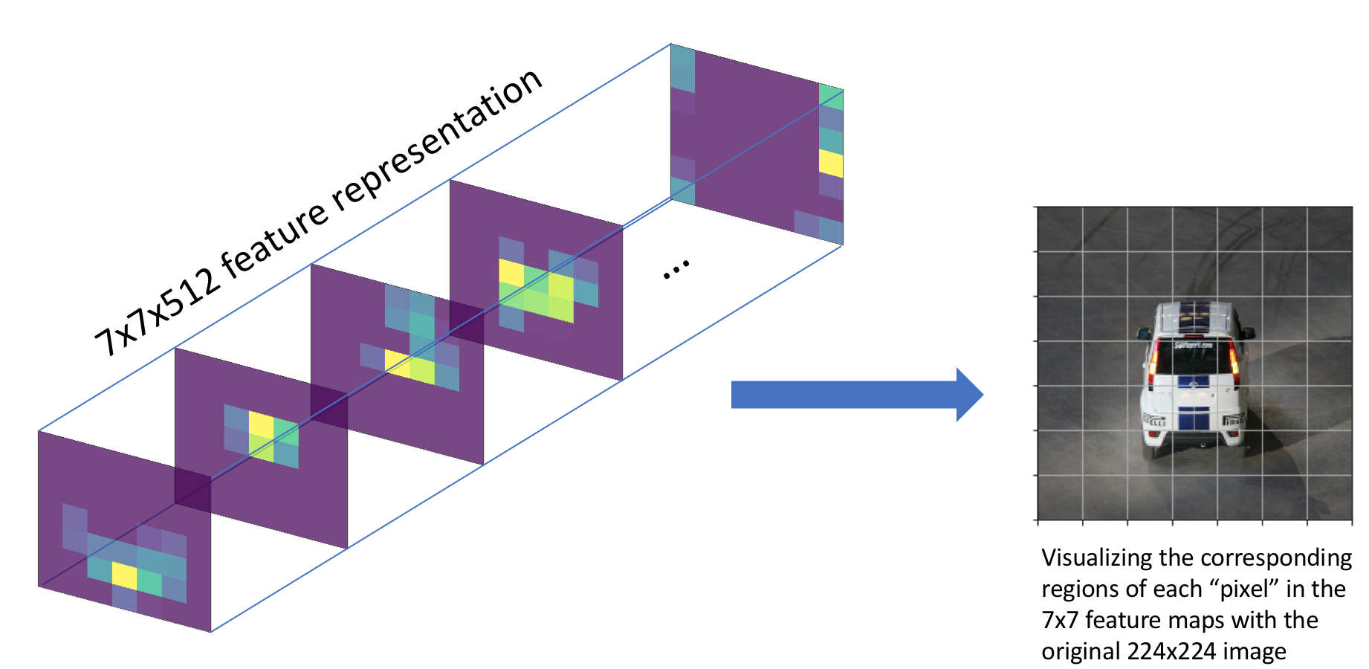
YOLO

Slide 7
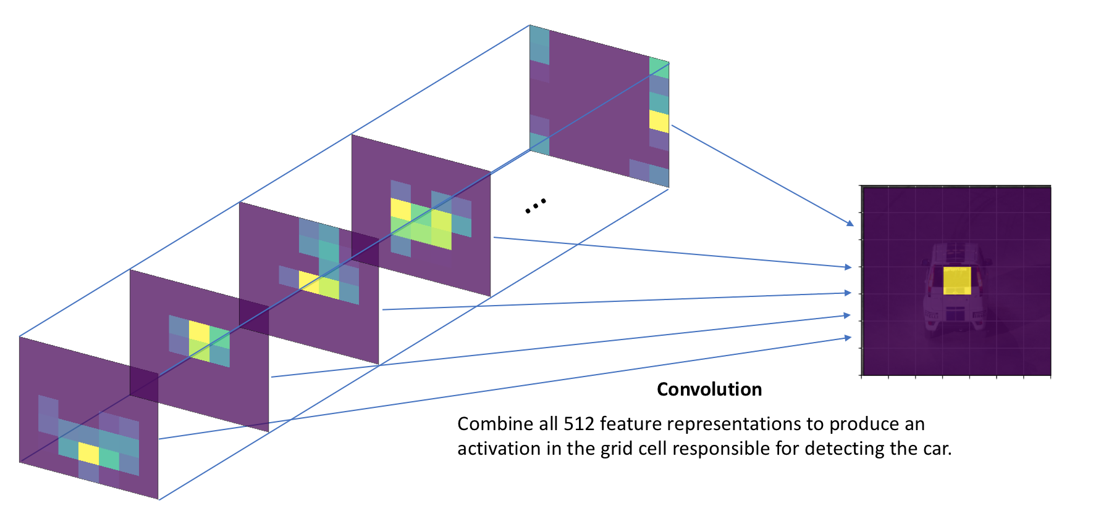
YOLO

Slide 8
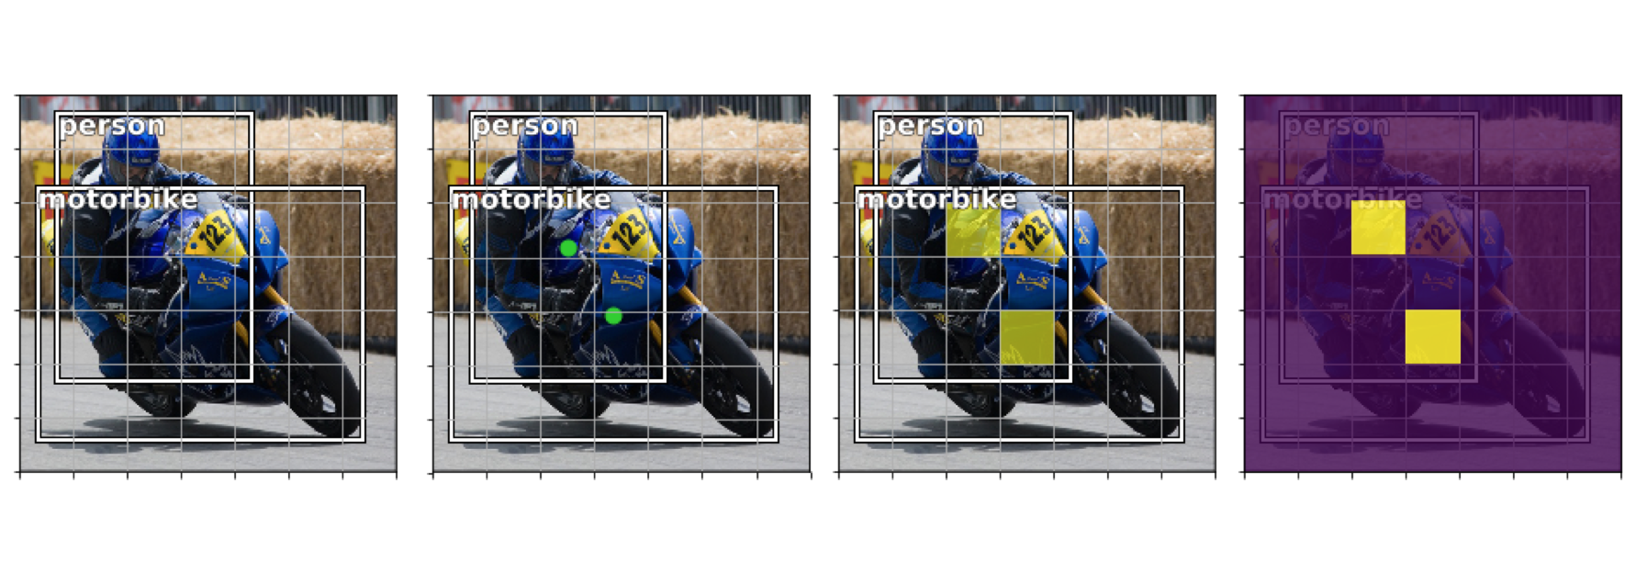
YOLO

Slide 9
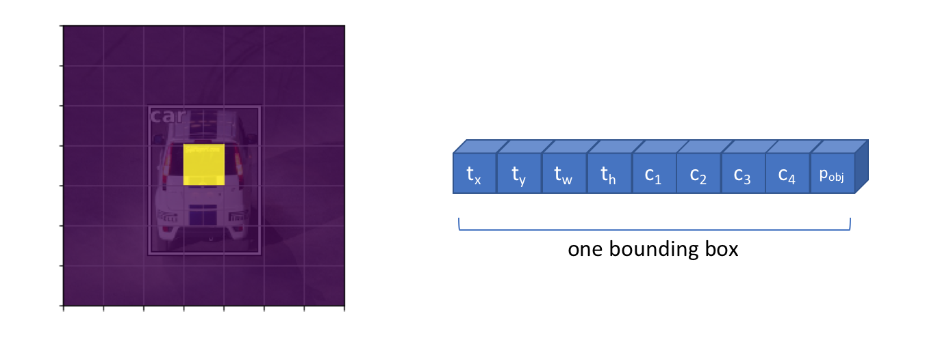
YOLO

Slide 10
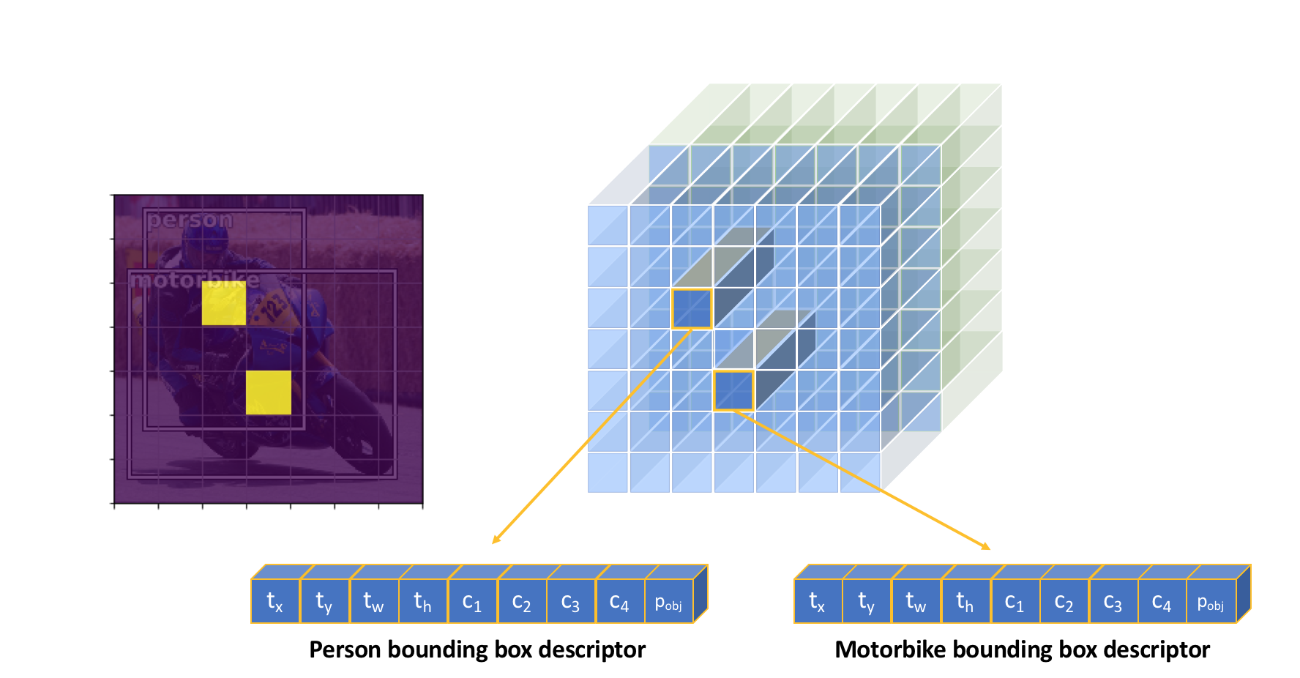
YOLO
A fixed number of multiple objects can be detected in parallel

Slide 11
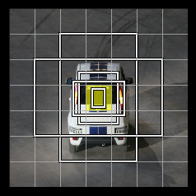
Anchors
YOLO uses anchors
YOLOv8 does not
Predicts directly the center of an object
Produces fewer predictions
NMS is faster

Slide 12
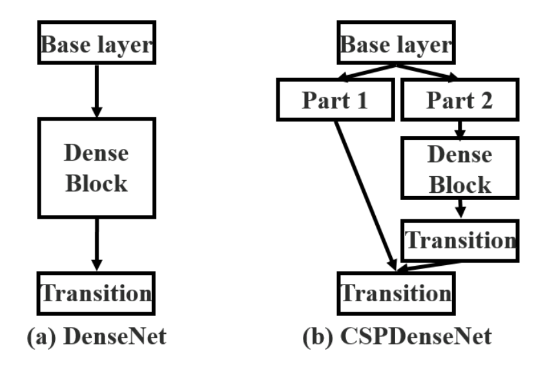
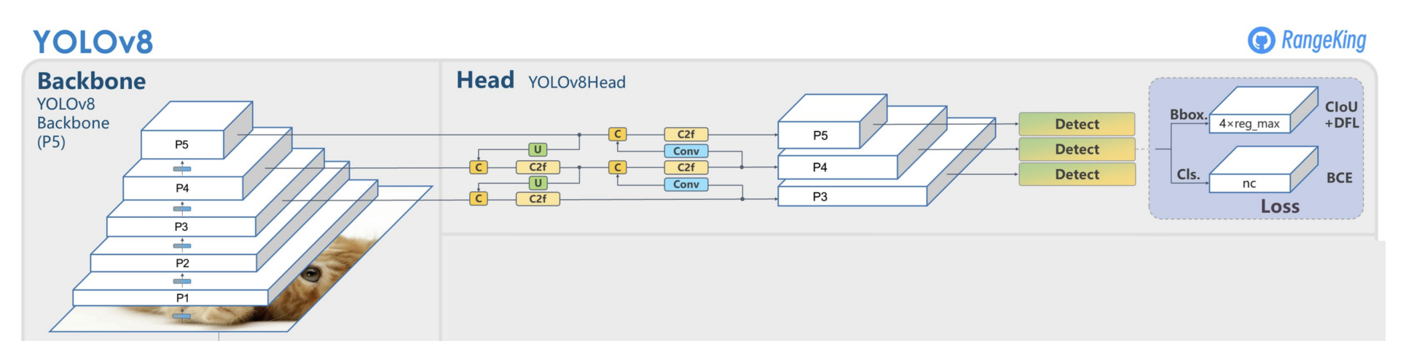
YOLO
Cross Stage Partial Network
Used with Dense Net, ResNet blocks
FPN
Path Aggregation
Skip connections

Slide 13
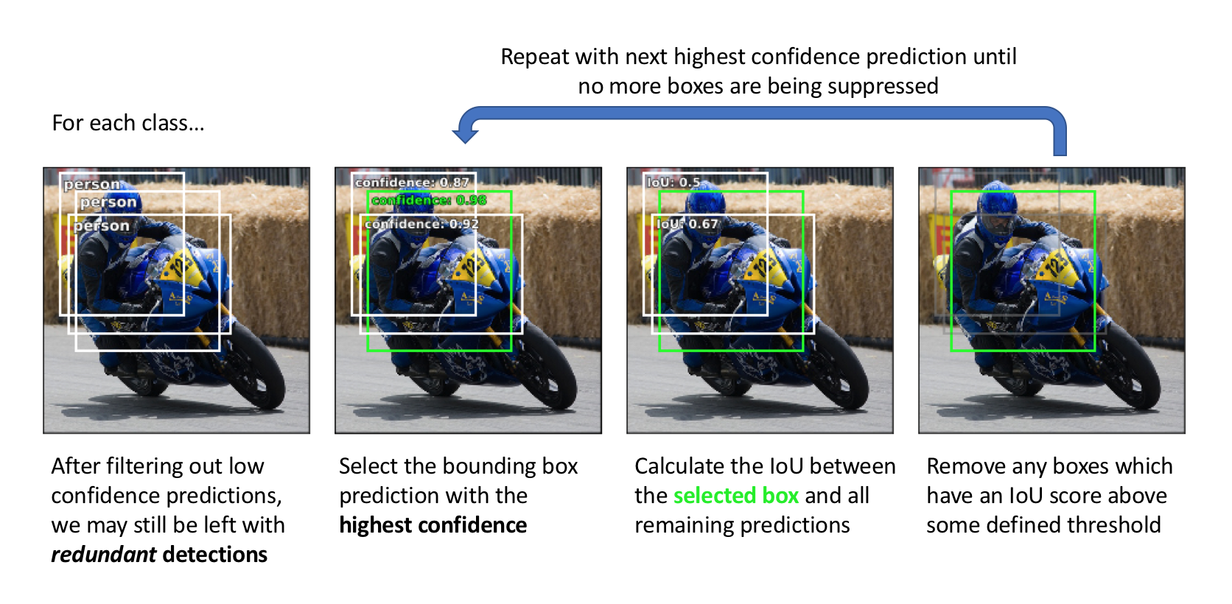
NMS
YOLOv8 uses Soft NMS – reduces confidence instead of removing

Slide 14
Decision to Brake
Car

Slide 15
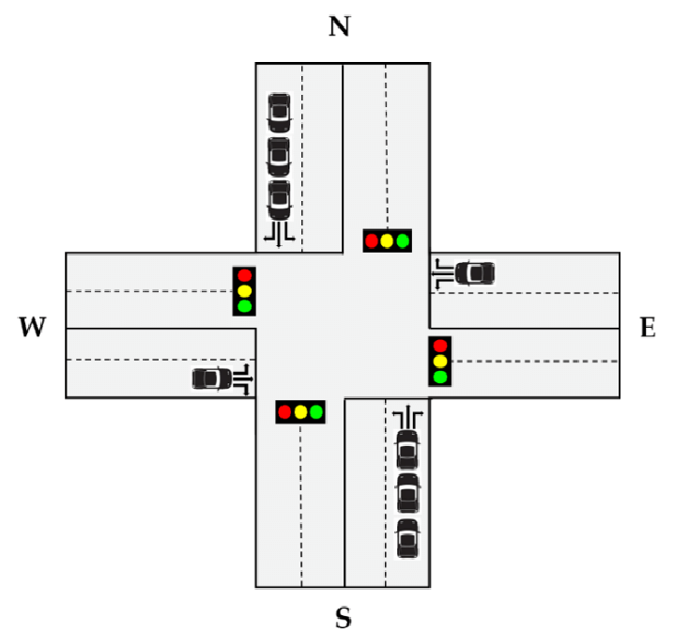
Decision to Brake
Multiple detections?

Slide 16
Intersection
Need to Detect Intersections
Car stops at wrong place
SegFormer model for Road Segmentation
Too Slow
Couldn’t make it accurate enough

Slide 17
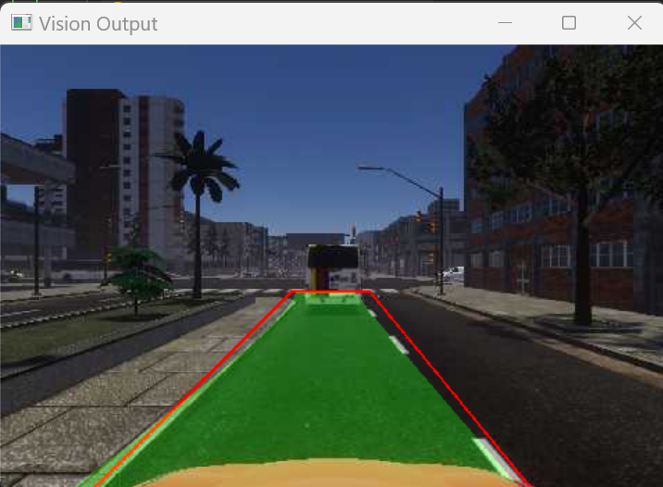
Lane Detection
CNN based
Problem with Low FPS
Traditional Method

Slide 18
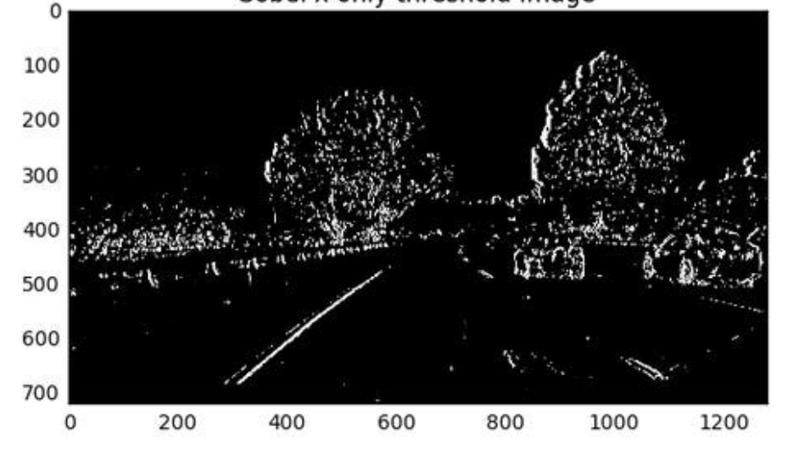
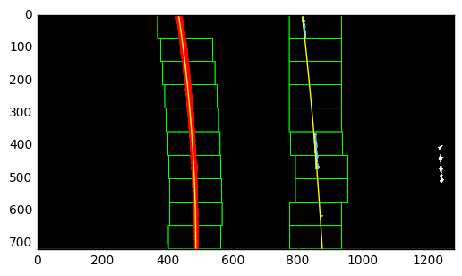
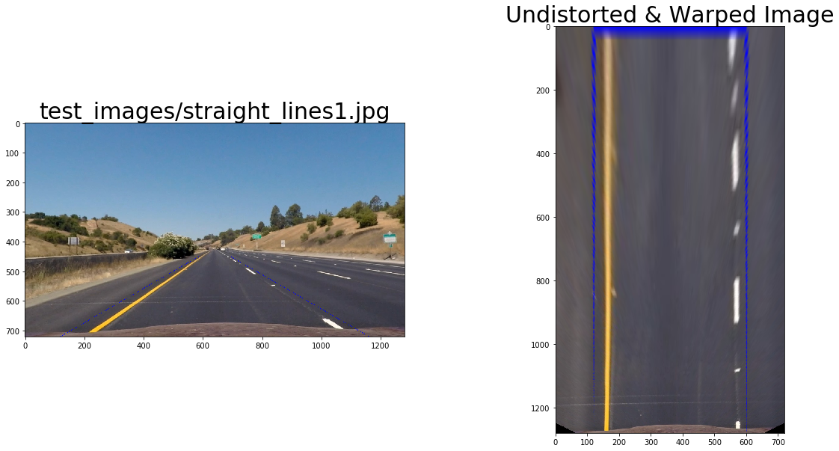
Lane Detection

Slide 19
FPS
Reduced Speed Limit
Use of probability
Start one Thread per Decision
Ignore new images in callback temporarily

